Slide 1

Excel Reassement
Sneha O
4313

Slide 2
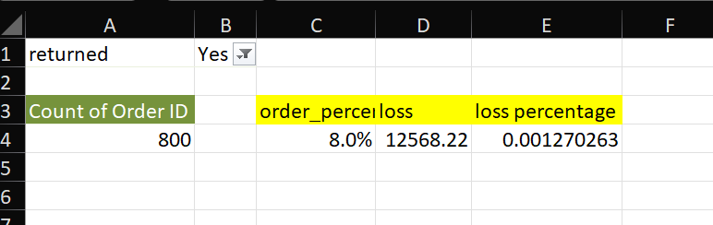
Answer 1
Insights: 800 people have returned orders which is about 8 percentage and the loss and respective percentage is comparatively less

Slide 3
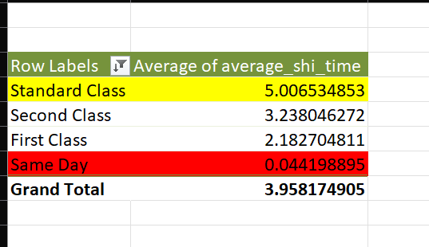
ANSWER 2
INSIGHTS: SAME DAY IS THE FASTEST WHILE THE STANDART CLASS DELIVERY IS THE LOWEST

Slide 4
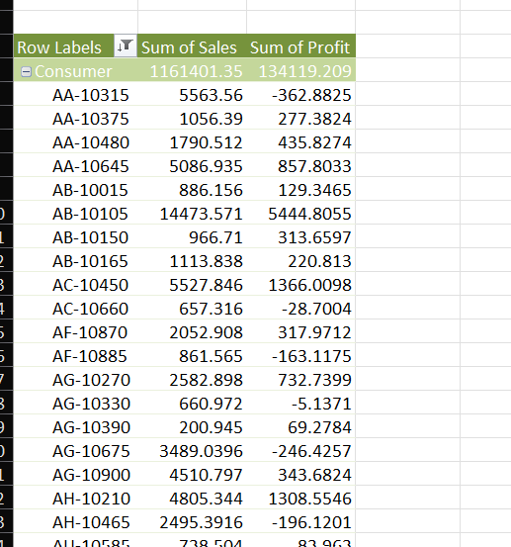
Answer 3
THE CONSUMER SEGMENT HAS THE MOST PROFIT ,SALES ETC.

Slide 5
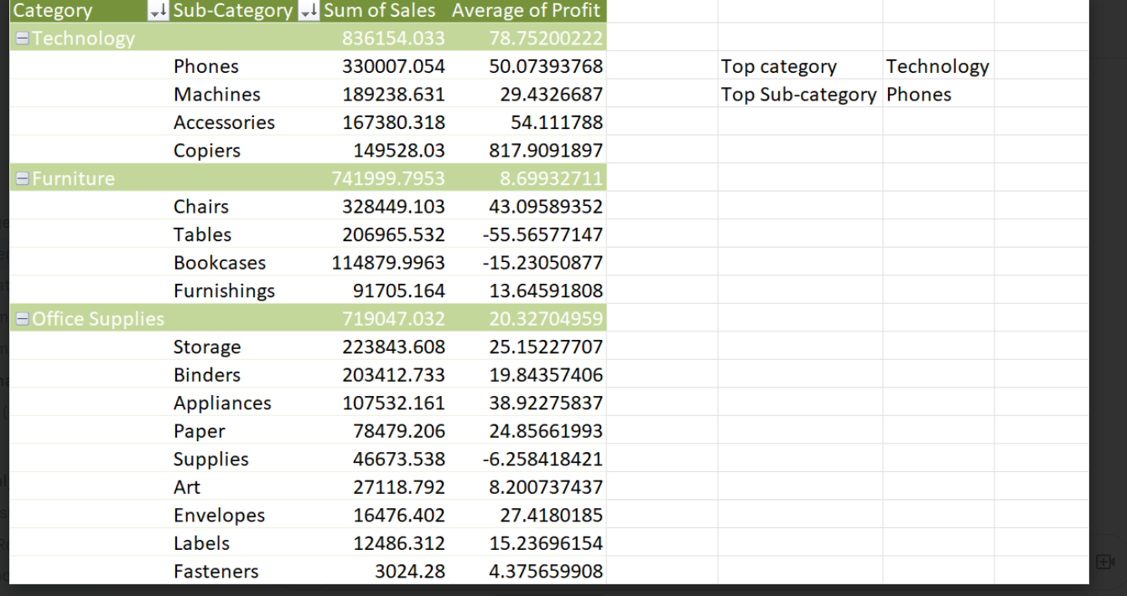
Answer 4
THE TECHNOLOGY CATEGORY AND THE ITS SUB_CATEGORY PHONE THE MOST
POPULAR FROM THE ABOVE CALCULATIONS.

Slide 6
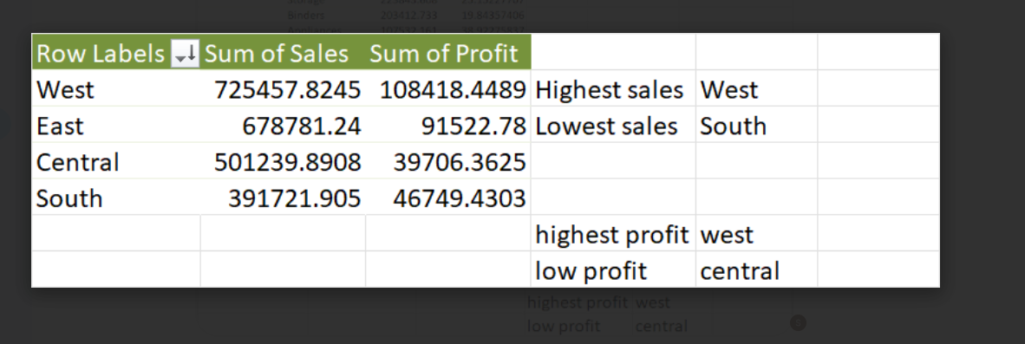
Answer 5
WEST REGION HAS THE HIGHEST SALES
WHEREAS SOUTH REGION HAS THE LOWEST SALES
WEST HAS THE HIGHEST PROFIT AND THE CENTRAL REGION HAS THE LOWEST
PROFIT.

Slide 7
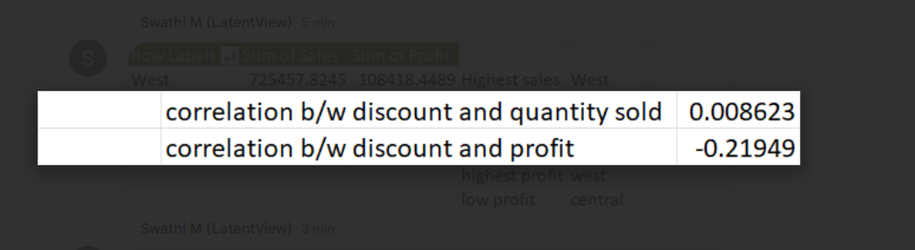
Answer 6
The profit and discount has negative correlation while the discount and quantity sold has positive correlation overall

Slide 8
Answer 7
The accessories sub category has the most no of orders overall and bimders and the papers
has the peak counts of orders and it’s the most ordered

Slide 9
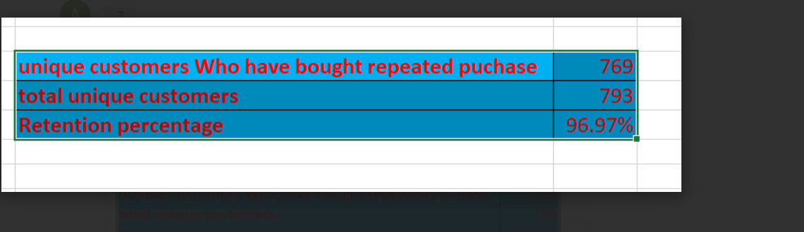
Answer 8

Slide 10
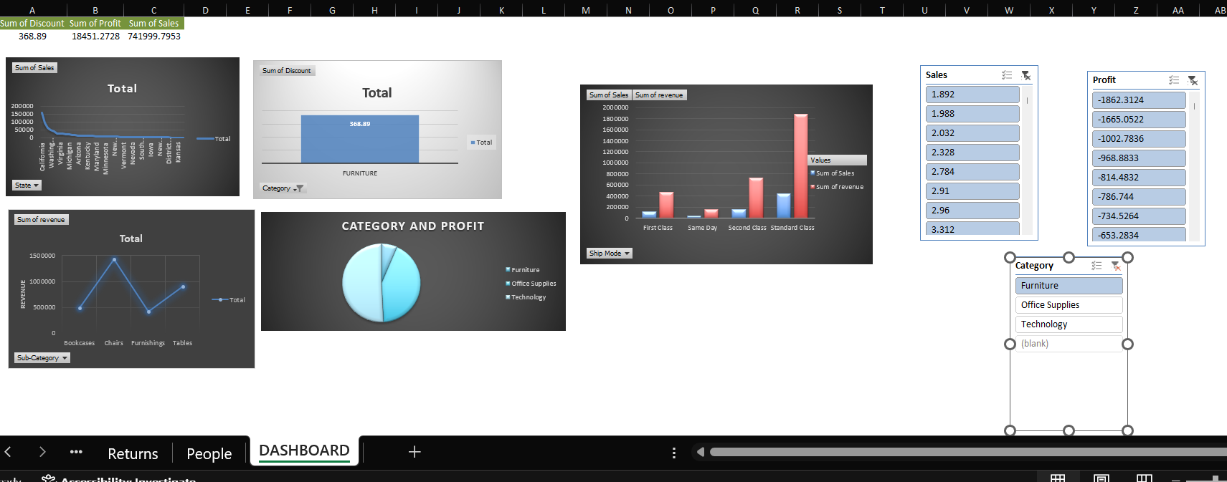
Answer 9
Standard class ship mode has the most amount of profits and revenus which makes it the most pefered.
From the pic chart – the technology category has the most profit while the furniture has less.
From the line chart it is clear that the subcategory chairs shows a significant peak in the overall revenue of the products which makes it the most desired and consumed product

